Slide 1

CFID Clinical COVID19 Webinar
Speakers
Dr Jonathan Grein-
Cedars-Sinai Medical Center, L.A.
Dr Shariq Haider- McMaster University
Moderator
Dr Curtis Cooper- University of Ottawa

Slide 2

Our Mission
The Canadian Foundation for Infectious Diseases is a charitable organization committed to improving the health of Canadians and people worldwide through the support of research and dissemination of knowledge pertaining to the prevention, diagnosis, control and treatment of infectious diseases.
www.researchid.com
cfid@research.com

Slide 3
Dr. Curtis Cooper - President
The Ottawa Hospital
Ottawa, ON
Term: 2015 - 2022
Dr. Susan Richardson- Past President
The Hospital for Sick Children
Toronto. ON
Term: 2008 - 2021
Dr. Shariq Haider- Vice-President
McMaster University Medical Centre
Hamilton, ON
Term: 2018 - 2024
Michel Picard, CPA CA- Treasurer
KPMG LLP Canada
Toronto, ON
Term: 2013 - 2021
Dr. Larissa Matukas
Secretary
St. Michael’s Hospital
Toronto, ON
Term: 2018 – 2026
Dr. Greg Hammond
Winnipeg, MB
Term: 2015 - 2021
Dr. Philippe Lagace-Wiens
Saint-Bonaface Hospital
Winnipeg, MB
Term: 2015 - 2021
Andrew Matejcic
Canadian Association for HIV Research
Ottawa, ON
Term: 2018 – 202X
Robert Dionne
CFA, CPA, CMA, DSM, FCSI, Badmin
Oakville, ON
Term 2020-2023
Dr. Coleman Rotstein
University of Toronto, University Health Network
Toronto, ON
Term: 2015 – 2021
Dr. Dan Gregson
University of Calgary
Alberta Health Services
Alberts Public Laboratories
Calgary, Alberta
Term: 2018 – 202X
Dr. Stuart Rosser
Edmonton, AB
University of Alberta
Term: 2019 – 202X
Andrea Holder
Shelley Mineault
David Mackie

Slide 4
www.researchid.com
Promoting and Funding Research
Grants are awarded to encourage research in specific ID/MM areas:
  CFID Safe Drinking Water Pilot Project Grant
  CFID Theme-specific Pilot Project Grants
Grants are awarded to both undergraduate students and medical students:
  AMMI-CFID Canada Medical Student Research Grant
  CFID Undergraduate Summer Research Grant
  altona Diagnostics Canada Medical Student Research Award
Awards
  John M. Embil Mentorship Award in Infectious Diseases
  Juan A. Embil Trainee Award for Excellence in Infectious Diseases Research

Slide 5





Slide 6



Webinar Format
Agenda
COVID19: Update on Clinical Management- Dr Grein
Case Presentations- Drs Grein, Haider, Cooper
Discussion / Q&A
Learning Objectives
1. To provide an update on clinical management of Covid-19 infection
2. Explore lessons learned from clinical Covid-19 cases

Slide 7
Disclosures
Jonathan Grein
    Speakers: Gilead
Shariq Haider
  Grants/Research Support: Merck, ViiV, Gilead, BMS, Takeda Pharma, Roche Pharma
  Speakers: Abbvie, Merck, ViiV, Gilead, AVIR Pharma, Verity Pharma
Curtis Cooper
  Grants/Research Support: Gilead, Abbvie
  Speakers: Abbvie, Merck, ViiV, Gilead
Notes:
This slide must be visually presented to the audience AND verbalized by the speaker.

Slide 8
COVID-19: Update on Clinical Management
December 8, 2020
Jonathan Grein, MD
Director, Hospital Epidemiology
Cedars Sinai Medical Center
Associate Clinical Professor
David Geffen School of Medicine at UCLA
Disclosures: Speakers honorarium (Gilead)

Slide 9
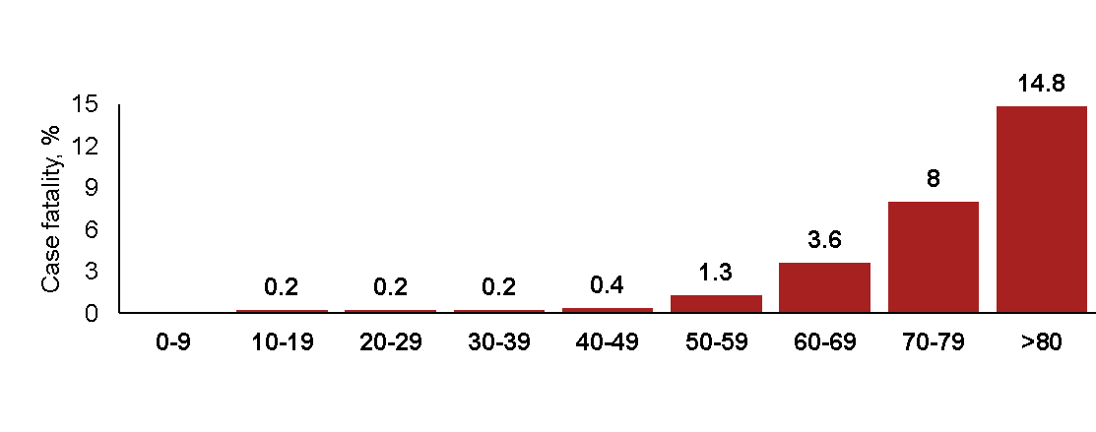
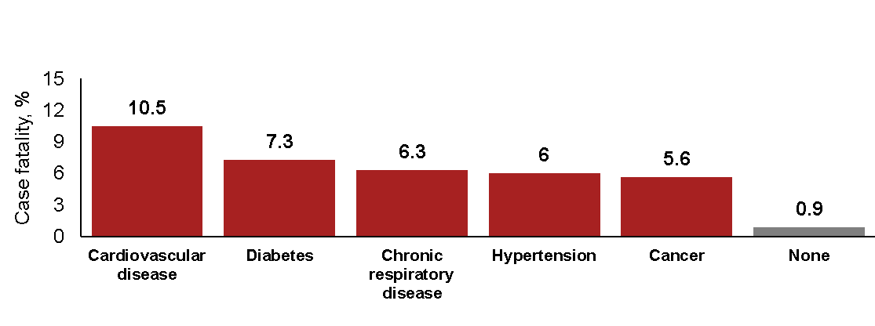
COVID-19 Treatment Strategies: A Primer
Mortality by Age
Mortality by Co-Morbidity
Most patients recover without the need for medical intervention
Mild illness in ~80%, critical illness in ~5%
Risk factors for mortality include older age and presence of co-morbidities

Slide 10
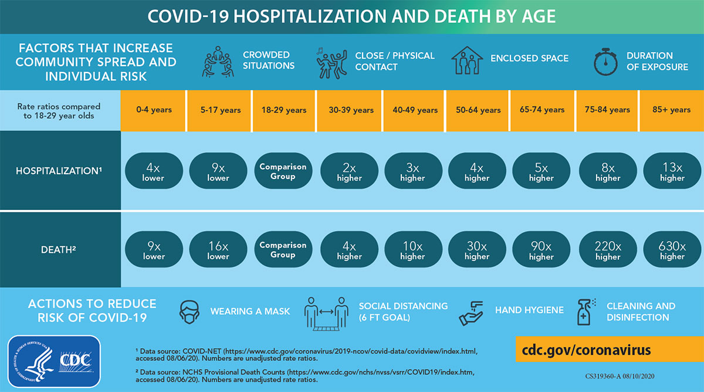
Age as a Risk factor for Severity

Slide 11
Sanders et al, JAMA Apr 13, 2020

Slide 12
COVID-19 Spectrum of Illness

Slide 13

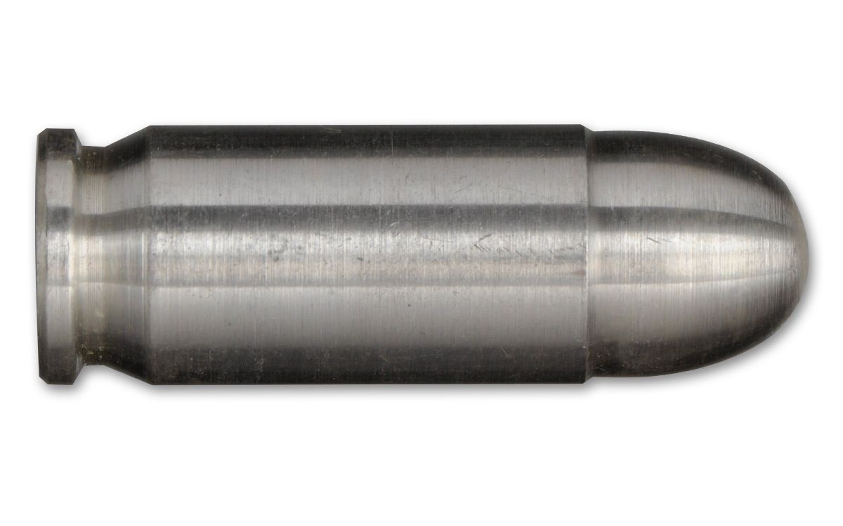
Building a Toolbox: Therapeutic Options for COVID-19
Anti-Viral Agents
Hydroxychloroquine
Remdesivir
Immune-Based Treatment
Dexamethasone
Baricitinib
Monoclonal antibodies

Slide 14
COVID-19 Treatment Recommendations
Disease Severity | NIH Guidelines | IDSA Guidelines
Not hospitalized | Recommends against use of dexamethasone (AI) Insufficient data to recommend for or against bamlanivimab or casirivimab/imdevimab | Recommends against bamlanivimab routinely (Conditional, very low evidence); reasonable in patients at increased risk
Hospitalized without the need for supplemental oxygen | Insufficient data to recommend for or against remdesivir Recommend against dexamethasone (AIIa) | Recommends against dexamethasone (conditional, low evidence)
Requires supplemental oxygen | Remdesivir (BIIa), or Remdesivir + dexamethasone (BIII), or Dexamethasone if remdesivir not available (BI) | Dexamethasone (Conditional recommendation, moderate evidence) Remdesivir (Conditional, moderate evidence)
Requires high-flow or non-invasive ventilation | Dexamethasone (AI), or Remdesivir + dexamethasone (BIII) | Dexamethasone (Conditional recommendation, moderate evidence) Remdesivir (Conditional, moderate evidence)
Requires invasive ventilation or ECMO | Dexamethasone (AI) | Dexamethasone (Strong recommendation, moderate evidence) Remdesivir (Conditional, moderate evidence)
Suggests against tocilizumab in hospitalized patients (conditional, low evidence)
Convalescent plasma only in context of clinical trial in hospitalized patients (knowledge gap)

Slide 15
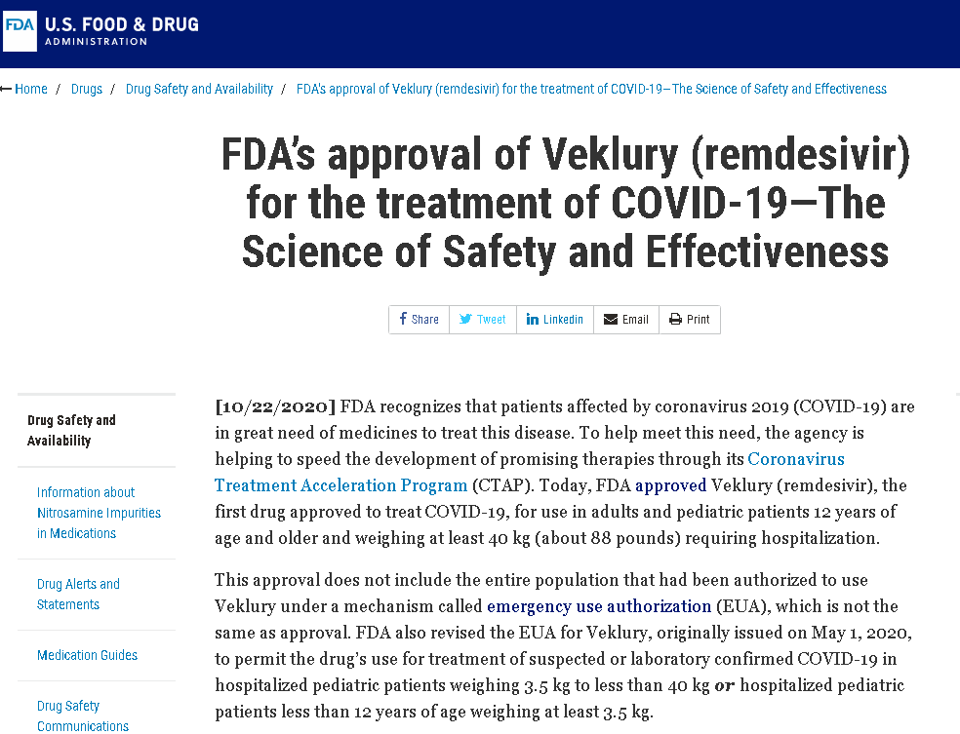
Remdesivir Approved for Hospitalized COVID-19 Patients

Slide 16
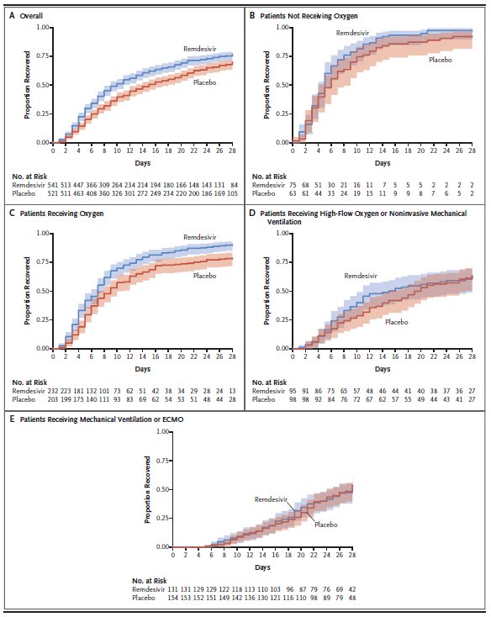
Remdesivir in Hospitalized COVID-19 Patients: ACTT-1 Findings
ACTT-1 Trial (NIH):
1,062 hospitalized adults randomized to remdesivir (10d) vs. placebo
Avg age 58.9 years, 55% with ≥2 comorbidities (HTN, obesity, DM)
41% requiring supplemental oxygen, 27% required invasive ventilation at enrollment
Primary outcome: Time to recovery (no longer requiring supplemental oxygen or ongoing hospital care)
Results (Stopped early by DSMB):
Remdesivir associated with 31% faster recovery time (p<0.001)
Trend towards lower 29-d mortality (11.4% vs. 15.2%; HR 0.73; 95% CI, 0.52 to 1.03).
Serious adverse events more frequent in placebo-arm (24.6% vs. 31.6%, respectively)

Slide 17
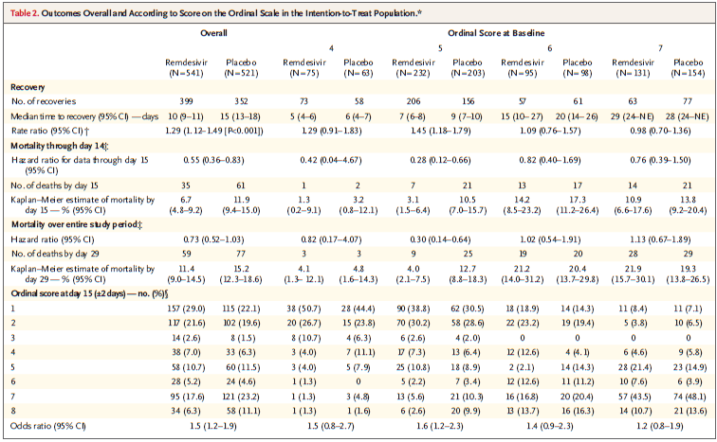
Remdesivir in Hospitalized COVID-19 Patients: ACTT-1 Findings
Significant mortality benefit in patients on supplemental oxygen
Bieigel JH et al, NEJM 2020; 383: 1813-26

Slide 18
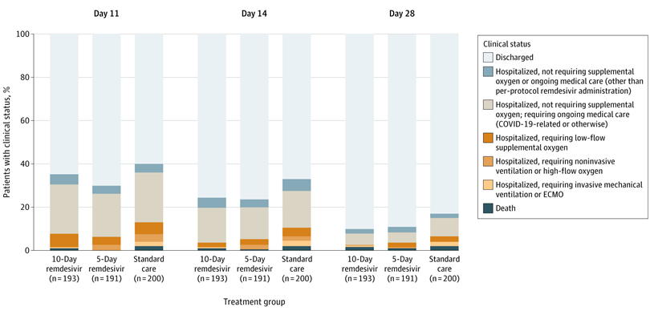
Remdesivir for Mild/Moderate COVID-19 Illness?
Randomized open-label trial comparing remdesivir 5-d (n=199) and 10-d (n=197) to standard care (n=200) in hospitalized patients with moderate pneumonia (infiltrates and >94% SaO2 on room air)
Remdesivir 5-d associated with better clinical status at day 11 compared to standard care (OR 1.65, 95%CI 1.09-2.48); however, the 10-d group was not associated with improvement
No difference in time to improvement or recovery, duration of oxygen therapy, or LOS. Overall 28-day mortality was low (<2%) and not different between groups.
Remdesivir was associated with more adverse events than placebo (nausea, hypokalemia, headache), though serious adverse events were numerically lower
Open-label design may have influenced discharge decisions

Slide 19
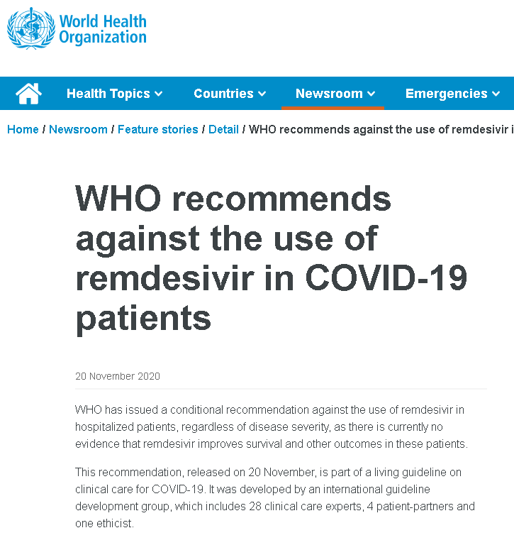
Remdesivir Controversy?

Slide 20
SOLIDARITY Trial (WHO)
RCT comparing multiple existing treatments (based on local availability) to local standard of care
Treatments evaluated: remdesivir, hydroxychloroquine, lopinavir, IFN-B1a
11,330 hospitalized adults in 405 hospitals across 30 countries
Primary outcome: In-hospital mortality; secondary outcomes included initiation of ventilation and hospital duration
Remdesivir arm (10-d): 2,750
Remdesivir death rate ratio: 0.95 (95% CI
0.81 – 1.11)

Slide 21
SOLIDARITY Trial (WHO)
Strengths: Randomized, large sample size, diverse patient population, limited exclusion criteria
Limitations: Open-label, not placebo controlled. Limited data collection. Study drug assignment based on local availability. Mortality was primary outcome for moderate and severe COVID-19. Approximately 48% received corticosteroids.
Mortality driven by patients on ventilator
~25% of remdesivir patients did not require oxygen at enrollement

Slide 22

Remdesivir Combination Therapy?
Does Combining Remdesivir with Immune-Based Therapy Improve Outcomes?
ACTT-2: Remdesivir + Baricitinib (preliminary data available)
ACTT-3: Remdesivir + Interferon beta-1a (enrollment concluded, data not yet available)
ACTT-4: Remdesivir + Dexamethasone (enrollment beginning)

Slide 23
Remdesivir + Baricitinib For Severe COVID-19 Patients: ACTT-2
Baricitinib: Oral JAK-Inhibitor FDA approved for RA. Side effects include infections (TB), thrombosis
1,033 hospitalized severe COVID-19 pts randomized to remdesivir + baricitinib vs remdesivir + placebo
Preliminary findings (not yet published) → Baricitinib associated with reduction in:
Median recovery time (8 days to 7 days, HR 1.15, 95%CI 1.00 – 1.31, p=0.047)
Progression to ventilation (23% vs 28% by day 29, OR 0.74, 95% CI 0.56 - 0.99)
Trend towards lower mortality (4.7% vs 7.1% at day 29Kaplan Meier estimated difference -2.6% (95% CI -5.8%, 0.5%).
Safety: Baricitinib arm did not have higher SAE (15%) compared to control (20%), including infections and VTE.
Nov 19: EUA for baricitinib + remdesivir in hospitalized COVID-19 patients age 2 years or older requiring supplemental oxygen, invasive mechanical ventilation, or extracorporeal membrane oxygenation (ECMO).

Slide 24
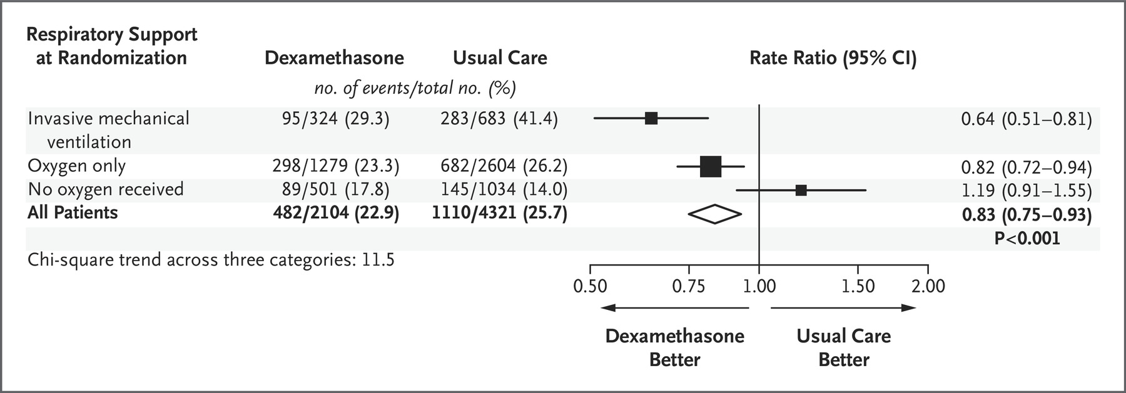
Dexamethasone in COVID-19: RECOVERY Trial
RECOVERY Trial (UK): Large, open-label RCT evaluating multiple therapeutic options in hospitalized COVID-19 patients
Dexamethasone 6mg PO/IV x10d (n=2,104) compared to usual care (n=4,321)
Overall, dexamethasone associated with 17% reduction in 28-d mortality (aRR 0.83, 95%CI 0.75 – 0.93)
  Dexamethasone also associated with shorter hospitalization and lower rate of progression to mechanical ventilation
Limitations: no data on viral clearance, adverse events

Slide 25
Dexamethasone in COVID-19: RECOVERY Trial
Largest benefit for those on mechanical ventilation
Trend towards harm in those not requiring oxygen
Bottom line:
Strong evidence for benefit of low-dose dexamethasone when given to patients requiring oxygen or invasive ventilation

Slide 26
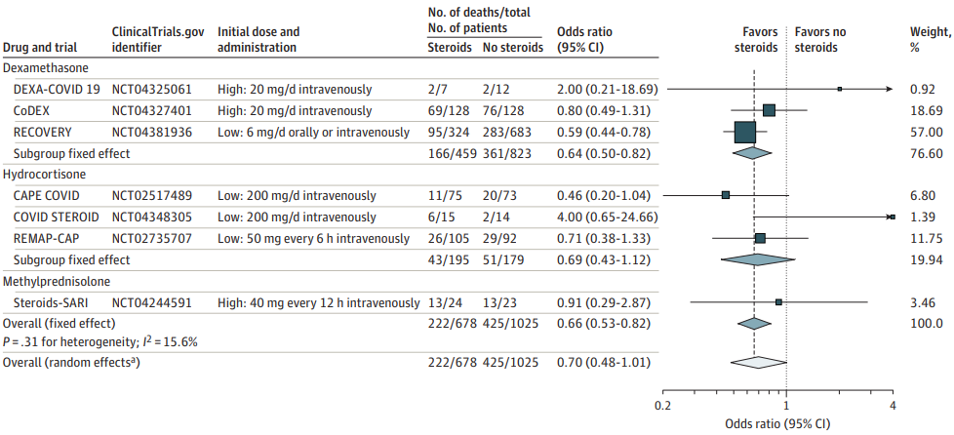
Corticosteroids in COVID-19: Meta-Analysis
Meta-analysis of 7 trials (n=1,703) evaluating corticosteroids in critically ill COVID-19 patients
Lower overall 28-d mortality (fixed-effect model OR 0.66, 95%CI 0.53-0.82)
  Similar trends regardless of steroid*, low vs high dose, mechanical ventilation, age, gender, or symptom duration (less effect in those requiring vasoactive medication)
No suggestion that corticosteroids associated with higher rate serious adverse events

Slide 27

Optimal Treatment?
What is the optimal treatment for a hospitalized COVID-19 patient on oxygen?
Dexamethasone?
Remdesivir + Baricitinib?
Remdesivir + Dexamethasone?
The answer may depend on cost, availability, and patient factors (comorbidity, preference)

Slide 28
Other Immune-Based Therapies
Multiple immune-based therapies under investigation, including:
    Interferon
    IL1-Inhibitors (e.g., anakinra)
    IL-6 Inhibitors (e.g., tocilizumab, sarilumab, siltuximab)
    Janus Kinase Inhibitors (e.g., ruxolitinib, and tofacitinib)
    Antibody-based treatments
    Others…
EUA granted (November) for monoclonal antibody treatments
bamlanivimab and casirivimab/imdevimab

Slide 29
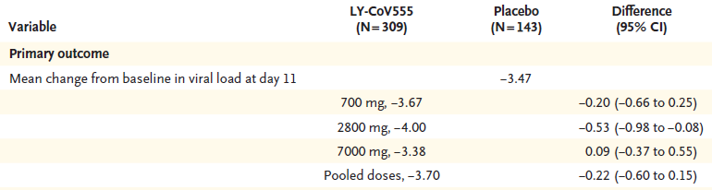
Bamlanivimab (Eli Lilly): Preliminary Data
Bamlanivimab (LY-CoV555): Potent antispike neutralizing monoclonal antibody that binds with high affinity to the receptor-binding domain of SARS-CoV-2
  Derived from convalescent plasma obtained from a patient with Covid-19
  Provides passive immunity against SARS-CoV-2 in nonhuman primates
Interim analysis of Phase 2 RDBPCT (BLAZE-1)
  Outpatients with mild/moderate COVID-19 (n=452)
  3 doses compared to placebo
  Intervention arm: median age 45, 88% white, 75% with mild symptoms, 70% with risk factors for severe COVID-19, enrollment at 4 days (median) from symptom onset

Slide 30
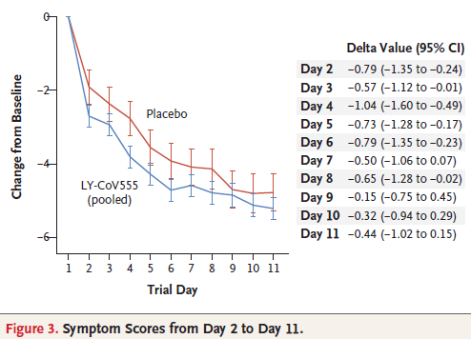
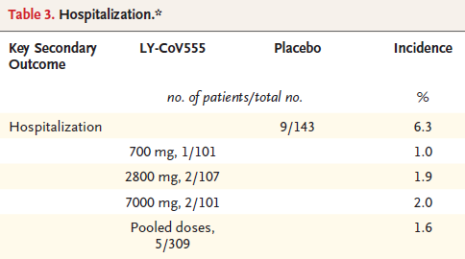
Bamlanivimab: Preliminary Data (Secondary Outcomes)
EUA (Nov 9) for bamlanivimab in non-hospitalized patients with mild to moderate COVID-19 (age 12 years and older) weighing at least 40 kg and who are at high risk for progressing to severe COVID-19 and/or hospitalization

Slide 31
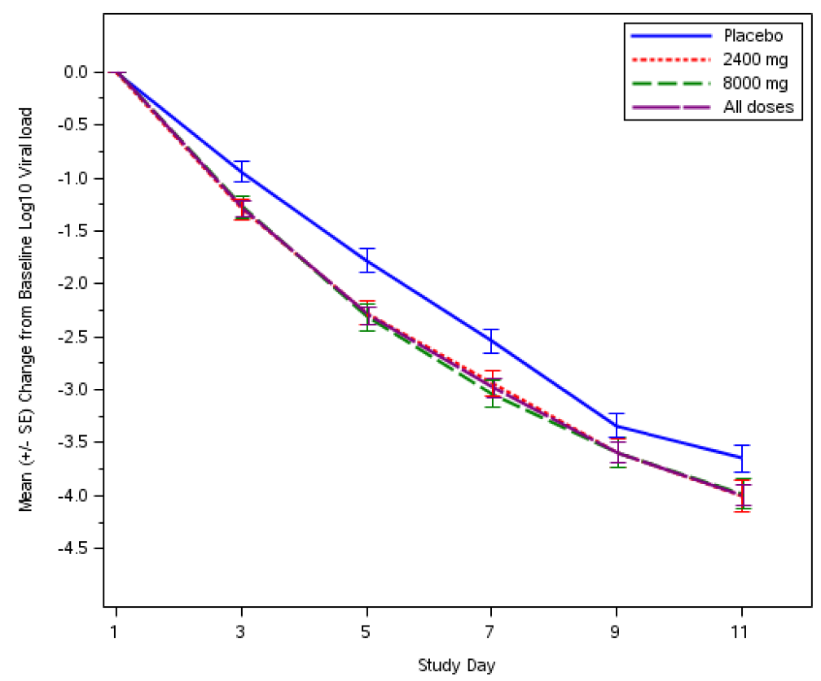
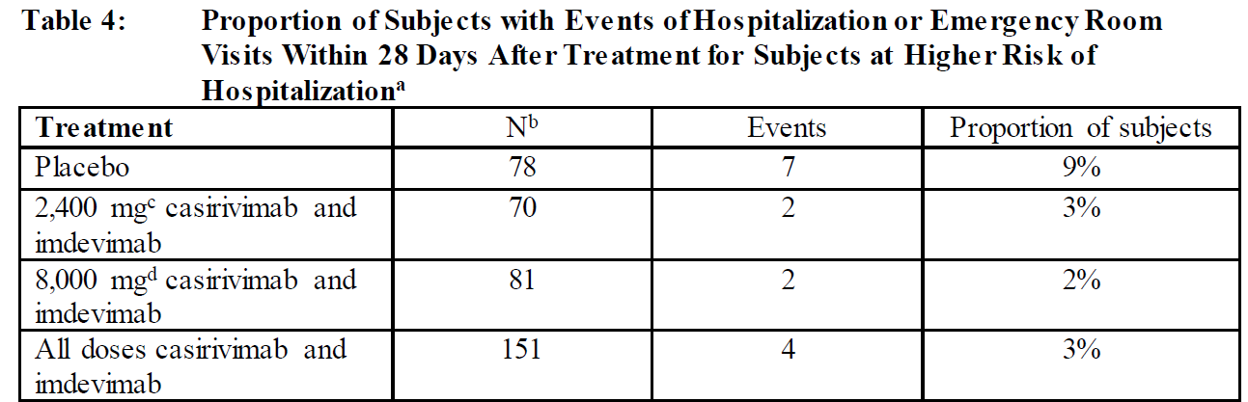
Casirivimab and imdevimab (Regeneron)
RDBPCT (n=799) of non-hospitalized adults with mild/moderate COVID-19 within 3 days of diagnosis
Primary outcome: Treatment was associated with significant viral load reduction at day 7
Secondary outcome: COVID-related medically attended visits within 28 days in patients at high risk for disease progression was 3% (n=4) in treated patients compared to 9% (n=7) in placebo
EUA (Nov 21) for Casirivimab/imdevimab in non-hospitalized patients with mild to moderate COVID-19 (age 12 years and older) weighing at least 40 kg and who are at high risk for progressing to severe COVID-19 and/or hospitalization

Slide 32
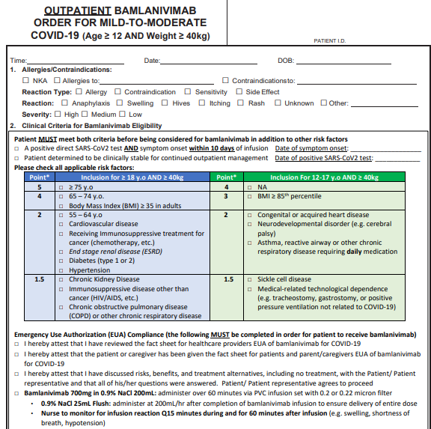
Monoclonal Antibodies: Factors to Consider
Well-Tolerated: but must monitor for infusion reactions
Requires 1-hour IV infusion followed by 1-hour observation
Infection Prevention and Staffing Challenges
Demand >> Supply requires rationing and prioritization

Slide 33
Summary of Current Therapeutic Strategies
Non-Hospitalized
Hospitalized
Mild
Moderate
Severe
Critical
Spectrum of Illness
Remdesivir +/- baricitinib
Dexamethasone
Bamlanivimab
Casirivimab / imdevimab
High-Quality Supportive Care

Slide 34
COVID-19 Therapeutics: Summary
Remdesivir is the only FDA-approved treatment for COVID-19; it can be considered in all hospitalized COVID-19 patients but likely has the most benefit in those with severe but non-critical illness
Dexamethasone is associated with reduced mortality in patients with severe/critical COVID-19, but should be avoided in patients with mild/moderate illness
Remdesivir + baricitinib appears associated with improved outcomes compared to remdesivir alone; unclear if baricitinib is superior to dexamethasone
Two monoclonal antibodies have recently received emergency use authorization based on preliminary data suggesting reduction in disease progression in non-hospitalized patients with mild/moderate illness; challenges include limited supply and logistics of infusion

Slide 35
Discussion

Slide 36
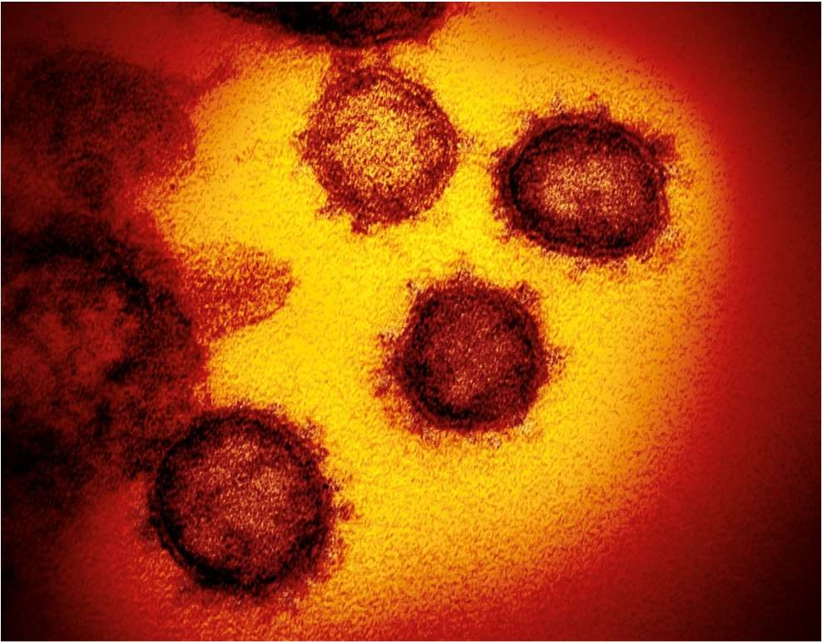
Case Studies

Slide 37
CASE #1
93 male from RH 3 day hx of diarrhea, vomiting, and weakness. Also complained dysuria and pain localized to the penis. DOA Nov 3/20
PMHX- Previous Bladder CA with surgery, Prostate CA no active tx, atrial fib, recurrent UTI with suprapubic cath, ILD by previous Xrays with pleural plaques, and CAD.
Triage vitals in ER: 36.5, HR 85, 128/85, RR 20, 93% on 2LNP
Assessment: Coarse crepitations in lung bases, and balanitis on exam
Labs: WBC 6.1,Hb 140 Plts 158, CR 88, Lactate N, INR/PTT 1.1/33, Urinalysis Turbid, CXRAY
Patient NPS sent off COVID 19/Resp Panel, and Blood cultures, and started on Ertapenem 1g q 24h.
NPS positive COVID 19 by PCR, patient started on Dexamethasone 6mg daily po and transferred to COVID Unit
By Nov 6/20 day 4 of Dexamethasone therapy, patient was on room air.

Slide 38
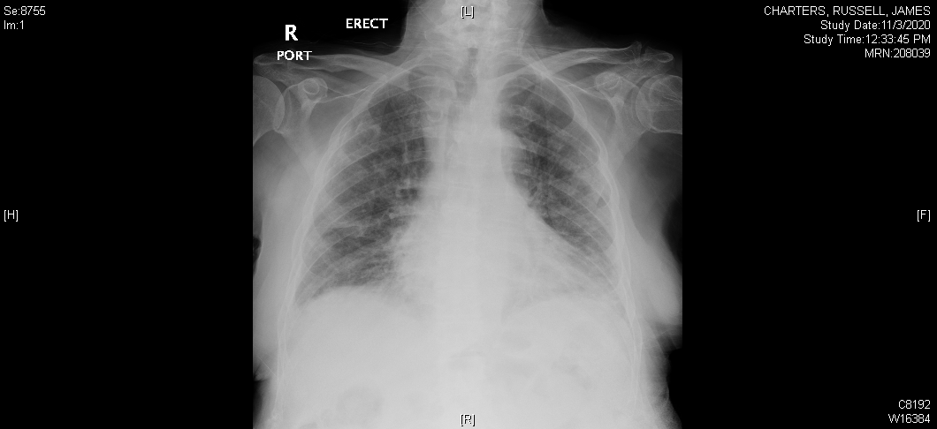
COVID 19 CXR
Admission (Nov 3/20)

Slide 39
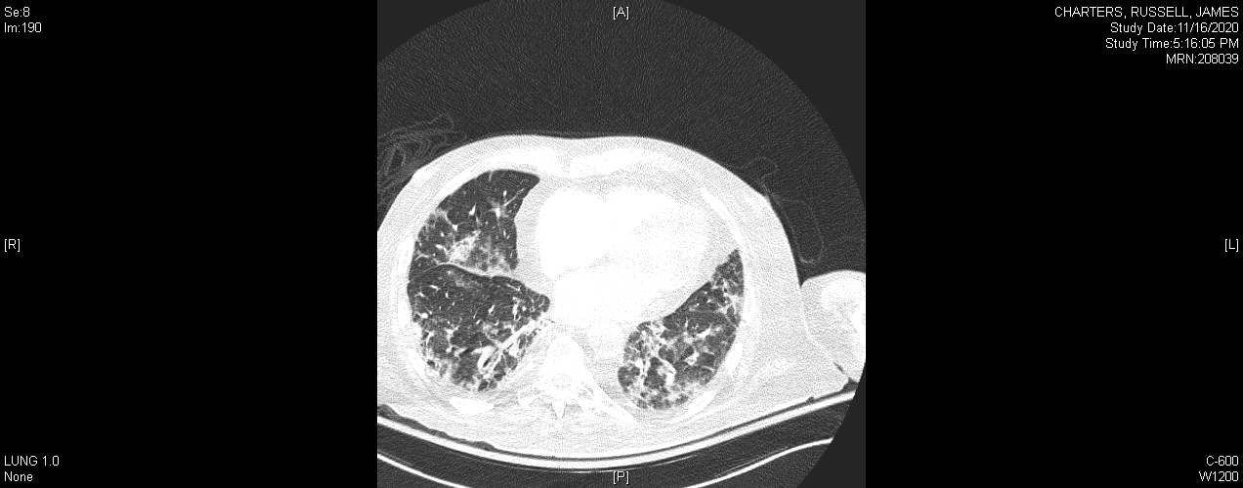
CT PE Protocol (Nov 16/20)
-bilateral interstitial thickening background calcified plaques and bilateral lower lobe airspace disease
-D Dimers>4000 / Normal INR/PTT

Slide 40
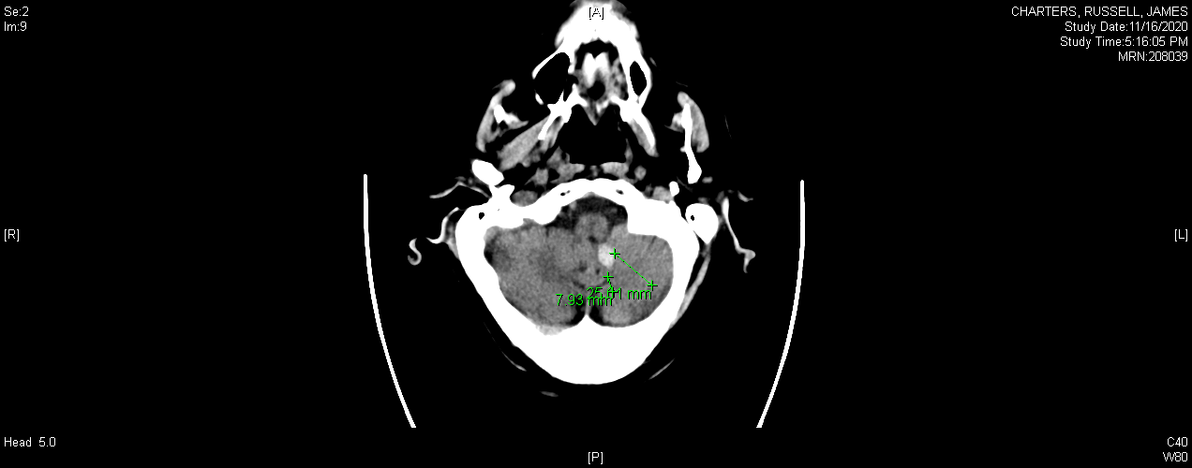
CT head (Nov 17/20)
Indication - aphasic and confused
Finding - left tonsillar bleed

Slide 41
CASE #1 Discussion Points
1. GI symptoms in COVID 19
2. CXR and CT findings in COVID 19
3. Dexamethasone
4. Elevated D Dimers
Clinical significance in COVID 19?
Risk of thrombosis and consumptive coagulopathy in COVID 19.
What are the recommendations for management?

Slide 42
Coagulopathies
The development of coagulopathy is the most significant poor prognostic feature of COVID-19¹
Mechanism is unclear, but may be related to cytokine storm¹
More Severe Disease in Patients with
Low Platelets and Elevated D-dimer²
Multivariate Correlative Factors of 28-day Mortality in Severe COVID-19³
 | Odds Ratio (95% CI) | P-value
Prothrombin time | 1.107 (1.008-1.215) | 0.033
D-dimer | 1.058 (1.028-1.090) | <0.001
Age | 1.033 (1.013-1.055) | 0.002
Platelet count | 0.996 (0.993-0.998) | 0.001
International Society on Thrombosis and Hemostasis recommends measuring D-dimers, prothrombin time, and platelet count (decreasing order of importance) in all patients who present with COVID-19 infection¹
Patients with COVID-19 may be at increased risk of coagulopathies

Slide 43
Treatment Dose Anticoagulation and
In-Hospital Survival Among Patients With COVID-19
New
Single-center, retrospective study at Mount Sinai Health System, New York, compared survival with treatment dose anticoagulation vs prophylactic dose or no anticoagulation in hospitalized patients with COVID-19, March 14 - April 11, 2020 (N = 2773)
  Median hospitalization duration:
  5 days
  Median anticoagulation duration:
  3 days
Longer duration of TDAC associated with reduced mortality risk (aHR*: 0.86/day; 95% CI: 0.82-0.89; P < .001)
Outcome | TDAC (n = 786) | No TDAC (n = 1987)
In-hospital mortality, % | 22.5 | 22.8
Median survival, days | 21 | 14
Mechanical ventilation, % In-hospital mortality, % Median survival, days | 29.8 29.1 21 | 8.1† 62.7 9
Major bleeding, % | 3 | 1.9
*Adjusted for age, sex, ethnicity, BMI, history of hypertension, heart failure, atrial fibrillation, type 2 diabetes, anticoagulation use prior to hospitalization, and admission date. †P < .001.
Paranjpe. JACC. 2020;76:122.
Notes:
aHR, adjusted HR; BMI, body mass index; TDAC, treatment dose anticoagulation.

Slide 44
Prophylactic Dose vs Therapeutic Dose
Anticoagulation in COVID-19
New
Retrospective, 2-center, cohort study compared in-hospital mortality with prophylactic dose vs therapeutic dose AC with heparin or low-molecular-weight heparin upon admission in COVID-19 patients, April 1-25, 2020 (N = 374)
  Excluded therapeutic AC for thrombotic indication; prophylactic AC group received only prophylactic dosing for whole inpatient duration
Outcome | Prophylactic Dose AC (n = 299) | Therapeutic Dose AC (n = 75)
In-hospital mortality, % | 14.4 | 38.7
Crude risk ratio (95% CI) P value | 2.7 (1.8-4.0) < .001
Adjusted risk ratio* (95% CI) P value | 2.3 (1.0-4.9) .04
*Logistical model included AC dosage, age, ethnicity, diabetes, history of heart disease or cancer, hyperlipidemia, intensive care, peak CRP, mechanical ventilation, and antibiotic use.
Motta. medRxiv. 2020;[Preprint]. Note: This study has not been peer reviewed.
Notes:
AC, anticoagulation; CRP, C-reactive protein.

Slide 45
Guidance on Thromboprophylaxis
New
Recommending Organization*
NIH^{[1]} | ASH^{[2]}
Hospitalized adults with COVID-19 should receive VTE prophylaxis per the SoC for other hospitalized adults Anticoagulant or antiplatelet therapy should not be used to prevent arterial thrombosis outside of the usual SoC for patients without COVID-19 Currently insufficient data to recommend for or against the use of thrombolytics or increasing anticoagulant doses for VTE prophylaxis in hospitalized COVID-19 patients outside of clinical trial Hospitalized patients should not be routinely discharged on VTE prophylaxis (extended VTE prophylaxis can be considered in patients with low bleeding risk and high VTE risk) | All hospitalized adults with COVID-19 should receive thromboprophylaxis with low-molecular-weight heparin over unfractionated heparin, unless bleeding risk outweighs thrombosis risk Fondaparinux is recommended in the setting of heparin-induced thrombocytopenia In patients in whom anticoagulants are contraindicated or unavailable, use mechanical thromboprophylaxis (eg, pneumatic compression devices) Encourage participation on clinical trials rather than empiric use of therapeutic-dose heparin in COVID-19 patients with no other indication for therapeutic dose anticoagulation
*Additional recommendations available from the International Society on Thrombosis and Haemostasis^{[3]}, and CHEST.^{[4]}
1. NIH. COVID-19 Treatment Guidelines. Updated: May 12, 2020. 2. American Society of Hematology. COVID-19 and VTE/ Anticoagulation: Frequently Asked Questions. 3. Spyropoulos. J Thromb Haemost. 2020;[Epub]. 4. Moores. CHEST. 2020;[Epub].
Notes:
ASH, American Society of Hematology; NIH, National Institutes of Health; SoC, standard of care; VTE, venous thromboembolism.

Slide 46
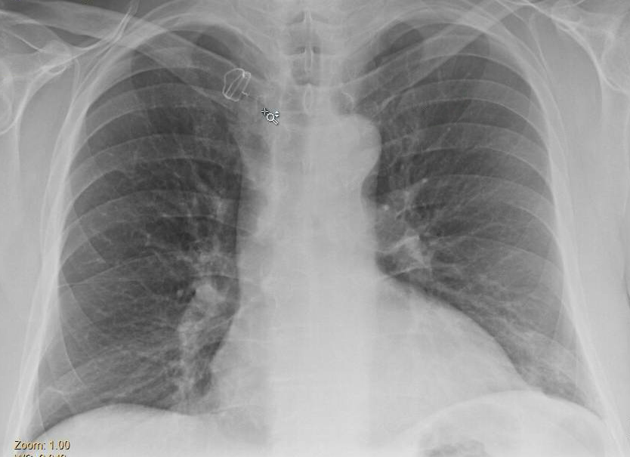
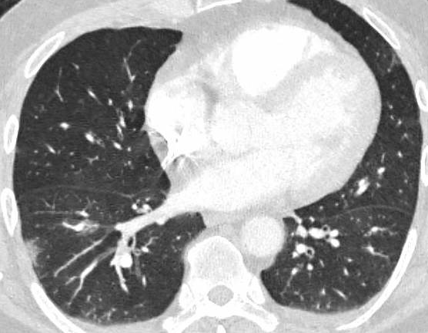
Case #2
65 year old male with asthma presents with 3 days of fatigue and dyspnea on exertion. He denies fevers, chills, cough, N/V, or diarrhea.
CXR performed at urgent care; referred to ED to rule out PE
T 97.6, HR 84, RR 20, BP 142/90, SaO2 94% on RA
No acute distress
CBC normal
BMP normal
CRP 0.35
SARS-CoV-2 DETECTED by PCR
Discharged home from ED
Two days later, fatigue/DOE persisted → referred for bamlanivimab 700 mg IVPB x1 dose
Discharged home; hospitalization not required
Slight increased pulmonary opacities in right lung base
Bilateral patchy peripheral groundglass opacities with rounded morphology and reversed halo sign

Slide 47
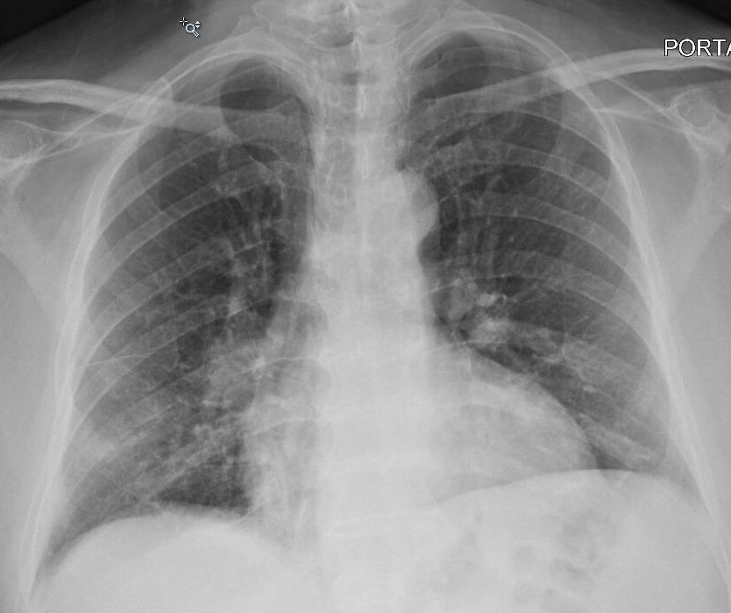
Case #3
80-year-old male with CAD, DM2, HLD and recent admission for renal colic with retained stone. Admitted now with L flank pain x2 d and fever x1 day. No cough, SOB, or GI symptoms.
T: 100.8°F BP: 112/67 HR: 101 RR: 20 SaO₂: 98% RA
No distress
Inspiratory crackles at the right lung base
Left CVAT
CBC: Normal
BMP: Normal
LFT: Normal
LDH: 200
IL-6: 4.6
D-dimer: 0.6
CRP: 55
SARS-CoV-2 DETECTED by PCR (NP)
Mild bibasilar atelectasis

Slide 48
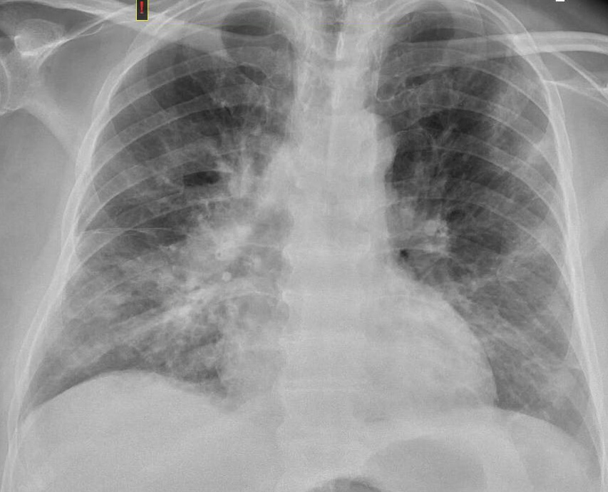
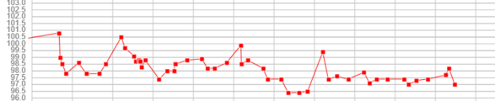
Case #3 (continued)
Admitted; developed N/V but no respiratory symptoms
Initiated on convalescent plasma x2 units
HD#5: Developed tachypnea and desat to 92%, CRP increased to 118
Initiated on dexamethasone + remdesivir
Proning
Supplemental oxygen (NC) used intermittently
Discharge home on HD#10
Repeat CXR (HD#6):
New bilateral infiltrates
Temperature During Hospitalization

Slide 49
Case #4
60-year-old male with COPD, HTN, and prior thyroid CA. He reports 6 days of malaise and diarrhea, followed by 2 days of progressive dyspnea and cough. Symptoms developed while vacationing in Mexico; dyspnea worsened on flight home.
T: 97.8°F BP: 124/68 HR: 86 RR: 32 SaO₂: 87% NRB
Diaphoretic, tachypneic
Decreased breath sounds
Admission labs:
CBC: WBC 11.9 (7% lymph), otherwise WNL
BMP: Creatinine 1.3, otherwise WNL
LFT: AST 106 ALT 93
IL-6: 36
D-dimer 4.4
CRP 13.1
Procalcitonin 0.55
SARS-CoV-2 DETECTED by PCR
Admission CXR:
Diffuse interstitial infiltrates, no focal consolidation

Slide 50
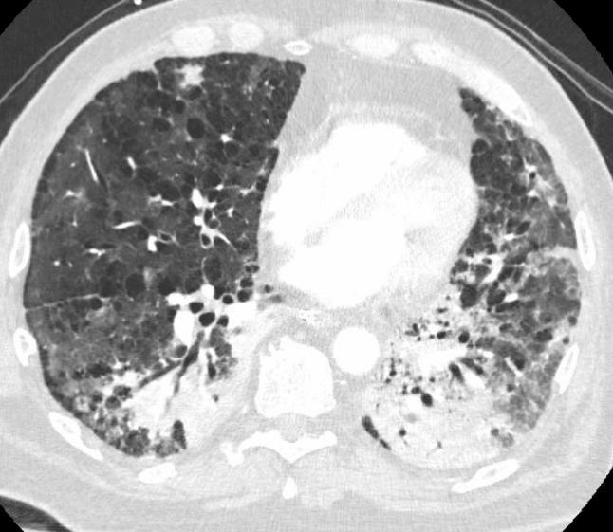
Case #4 (continued)
Initiated on remdesivir + dexamethasone
Ceftriaxone + azithromycin
SQ enoxaparin BID (LE Duplex negative)
Increasing oxygen requirements (40 L oxygen by HFNC)
Transient improvement in oxygenation with proning
HD#9 elective endotracheal intubation
CT Angio with multiple PE → heparin gtt
HD#18: New infiltrates + Pseudomonas from sputum
HD#28: Candida albicans central line infection
HD#30: Palliative extubation, death
Autopsy: Diffuse alveolar damage, diffuse areas of consolidation, pulmonary thromboemboli
CT Angio (HD#14):
Bilateral nonocclusive segmental and subsegmental pulmonary emboli within the right middle lobe, right lower lobe and left upper lobe branches. Bilateral pneumonia superimposed on severe emphysema

Slide 51
CASE #5
51 F Post Allogeneic Transplant (MRD) for AML April 23/15 with post transplant complications of chronic GVHD and sclerodermatous changes in skin and abdominal wall currently on no immunosuppressants.
Presented Nov 5/20 with fever, N/V, diarrhea and SOB to a peripheral hospital. Had COVID 19 screen pos COVID 19 PCR, no CXR done as patient had normal oxygen saturations and discharged home. She consulted Public Health who indicated at 14 days she could stop self isolating (as symptoms had resolved?)
Came for routine f/up with her Hematologist at our center Nov 17/20, and self reported after she had been assessed that she had been tested positive for COVID -19 and that she had new onset SOB and cough.
Vitals Nov 17/20: BP 130/85 HR 86 Sats 93% RA Afebrile CXR sent off
LABS: WBC 11.3 Neutrophils 6.8 Hgb 148 Plts 420 CXR Normal , Normal Quantitative Immunoglobulins

Slide 52
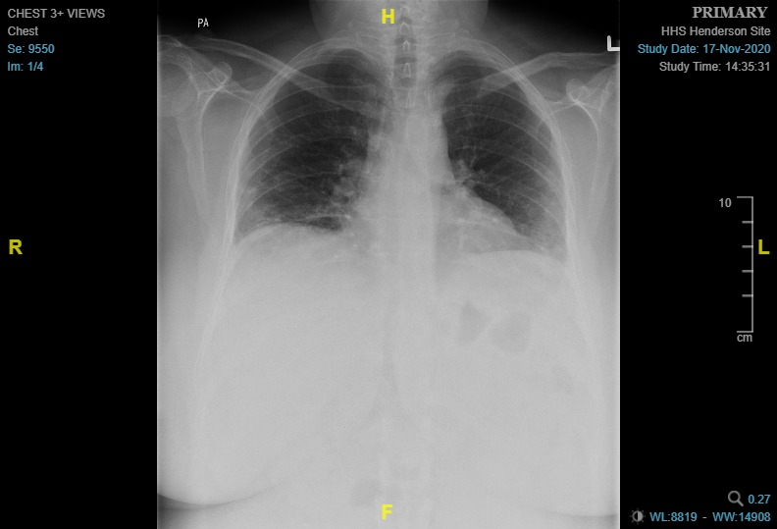
CXR (Nov 17/20)
- symptoms of cough and SOB
bilateral patchy peripheral airspace dx
Initial COVID 19 Test positive Nov 5/20, repeat test still positive Nov 17/20

Slide 53
CASE #5 Discussion Points
Are Immunosuppressed patients (Transplant, Cancer, HIV) at higher risk of infection? Do they present with more severe disease? Is there an impact on mortality rates?
How long do immunosuppressed patients shed COVID 19? Should we be extending their self isolation beyond 14 days if asymptomatic?
Are there special treatment considerations in immune compromised patients i.e. Dexamethasone, IL-6 inhibitors, etc?

Slide 54
Potential for Severe COVID-19 Outcomes in
Solid Transplant Patients
Report of outcomes among solid organ transplant recipients with SARS-CoV-2 at 2 centers in New York City during the first 3 wks of the outbreak (N = 90)
  Most common transplants were kidney (51%), lung (19%), liver (14%), and heart (10%)
Baseline Characteristic | All Patients (N = 90) | Mild/ Moderate Disease (n = 63) | Severe Disease (n = 27) | P Value
Median age, yrs (IQR) | 57 (46-68) | 54 (39-64) | 67 (56-74) | .001
Median time from transplant to diagnosis, yrs (IQR) | 6.6 (2.87-10.61) | 6.25 (2.6-10.69) | 6.86 (2.87-10.16) | .92
Hospital admission, n (%) | 68 (76) | 41 (65) | 27 (100) | < .001
Outcome,* n (%) | Hospitalized Patients (N = 68) | Mild/ Moderate Disease (n = 41) | Severe Disease (n = 27)
Intubation or ECMO | 24 (35) | 0 (0) | 23 (85)
ICU admission | 23 (34) | 0 (0) | 23 (85)
Mortality | 16 (24) | 0 (0) | 16 (59)
*Immunosuppressive therapy was reduced in all patients; 91% of patients were treated with hydroxychloroquine, 66% of patients were treated with azithromycin, and 3% of patients were treated with remdesivir.
Periera. Am J Transplant. 2020;[Epub].
Notes:
ECMO, extracorporeal membrane oxygenation; IQR, interquartile range.

Slide 55
Risk and Features of COVID-19 in Persons With HIV in the US
MGH series: 36 PWH with confirmed, 11 with probable COVID-19^{[1]}
  77% non-Hispanic black, Hispanic/Latinx (vs 40% black, Hispanic/Latinx in HIV clinic overall)
  85% had comorbidity associated with severe disease: obesity (33%), HTN (31%), DM (22%), hyperlipidemia (22%), chronic kidney disease (22%)
Mount Sinai Hospital System: case-control study^{[2]}
  PWH admitted with COVID-19 (n = 88) matched to HIV-negative group by age, race/ethnicity, sex, wk of COVID-19 hospitalization admission (n = 405)
  No differences in disease severity on admission (P = .15) or adverse outcomes (mechanical ventilation or death) with vs without HIV infection
1. Meyerowitz. 2020. AIDS;[Epub]. 2. Sigel. CID. 2020;[Epub].
Notes:
DM, diabetes mellitus; HTN, hypertension; PWH, persons with HIV.

Slide 56
Risk and Features of COVID-19 in Persons With HIV in the US
MGH series: 36 PWH with confirmed, 11 with probable COVID-19^{[1]}
  77% non-Hispanic black, Hispanic/Latinx (vs 40% black, Hispanic/Latinx in HIV clinic overall)
  85% had comorbidity associated with severe disease: obesity (33%), HTN (31%), DM (22%), hyperlipidemia (22%), chronic kidney disease (22%)
Mount Sinai Hospital System: case-control study^{[2]}
  PWH admitted with COVID-19 (n = 88) matched to HIV-negative group by age, race/ethnicity, sex, wk of COVID-19 hospitalization admission (n = 405)
  No differences in disease severity on admission (P = .15) or adverse outcomes (mechanical ventilation or death) with vs without HIV infection
1. Meyerowitz. 2020. AIDS;[Epub]. 2. Sigel. CID. 2020;[Epub].
Notes:
DM, diabetes mellitus; HTN, hypertension; PWH, persons with HIV.

Slide 57
COVID-19 and HIV: Routine Public Sector Data in Western Cape, South Africa
Evaluated factors among all adult public sector patients (3.5 million “active” patients)
Patient Characteristics
Sex
Female
Male
Age
< 40 yrs
40-49 yrs
50-59 yrs
60-69 yrs
≥ 70 yrs
Noncommunicable diseases
None
Diabetes well controlled (A1C < 7%)
Diabetes poorly controlled (A1C 7-9%)
Diabetes uncontrolled (A1C ≥ 9%)
Diabetes, no measure of control
Hypertension
Chronic kidney disease
Chronic pulmonary disease
Tuberculosis
Never tuberculosis
Previous tuberculosis
Current tuberculosis
HIV
Negative
Positive
Adjusted HR
1.00
1.40
1.00
3.12
9.92
13.55
19.53
1.00
4.65
8.99
13.02
3.34
1.46
2.02
0.98
1.00
1.41
2.58
1.00
2.75
95% CI
1.16-1.70
1.88-5.17
6.34-15.54
8.55-21.48
12.20-31.26
3.19-6.79
6.65-12.14
10.06-16.87
2.39-4.68
1.18-1.81
1.55-2.62
0.75-1.30
1.05-1.90
1.53-4.37
2.09-3.61
1
4
Standard mortality ratio for COVID-19 death with vs without HIV: 2.33 (95% CI: 1.83-2.91)
Davies, Western Cape DOH, South Africa. June 9, 2020. https://storage.googleapis.com/stateless-bhekisisa-website/wordpress-uploads/2020/06/94d3ea42-covid_update_bhekisisa_wc_3.pdf. Note: this study has not been published.

Slide 58
Questions & Answers

Slide 59

Acknowledgements
www.researchid.com

